Slide 1

^{Art + Game}
Gamedevs- games of the future

Slide 2

AGENDA
VISION
TECHNOLOGIES
PROJECT MANAGEMENT
LIVE DEMO
ARCHITECTURE
TESTING
YOUR QUESTIONS
Notes:
VISION - Danny
TECHNOLOGIES - Domi
PROJECT MANAGEMENT - Danny
LIVE DEMO - Adi
ARCHITECTURE - Domi
AUTOMATION - Adi
TESTING - Domi
YOUR QUESTIONS

Slide 3

^{VISION}
Gamedevs- games of the future

Slide 4





MOTIVATION
Why you need A+G
EXCHANGE WITH PEERS
FOCUS ON YOUR GOALS
BECOME AN EXPERT
BROADEN YOUR HORIZON
EXCEED EXPECTATIONS
GOAL:
Provide your knowledge, get rewarded, profit from other‘s experiences.

Slide 5
COMPONENTS
How A+G works

Slide 6

^{TECHNOLOGIES}
Gamedevs- games of the future

Slide 7

TECHNOLOGIES – C#
general-purpose, multi-paradigm programming language
Future proof programming language
Developed by Microsoft
Best Practices
Full Documantation
Faste and easy Software Development

Slide 8

TECHNOLOGIES – Unity
a cross-platform game engine
Future of Software Development
Open Source Project
Best Practices
Full Control
Faster Software Development → Lower Costs

Slide 9

^{PJM-TOOLS}
Gamedevs- games of the future

Slide 10
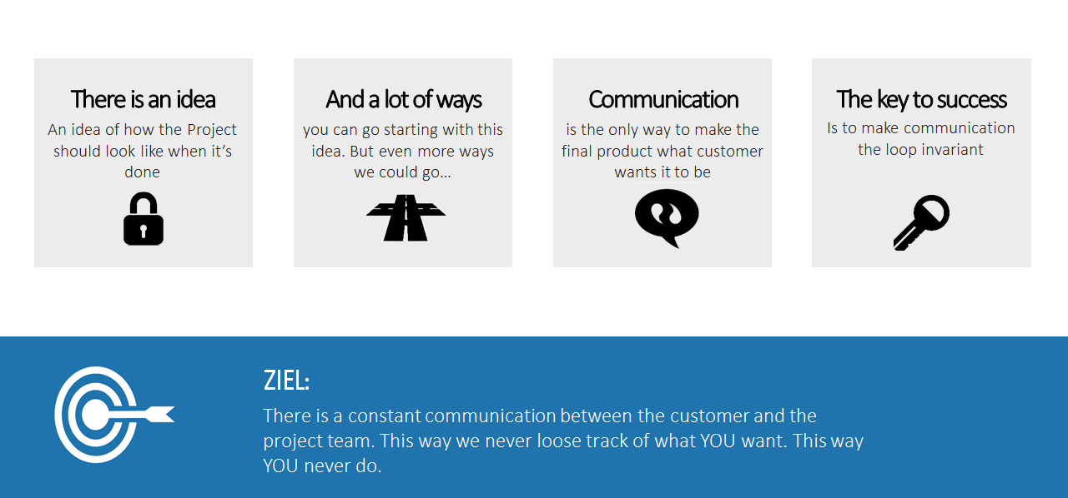
SCRUM
Why we do not waterfall

Slide 11


Platform
Where we stand on YouTrack

Slide 12

SPRINTS
How we get on board

Slide 13

SPRINTS
How we burn down

Slide 14

SPRINTS
How we keep track

Slide 15
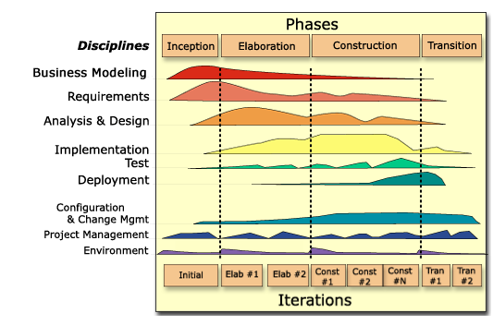
PLANING
@RUP

Slide 16
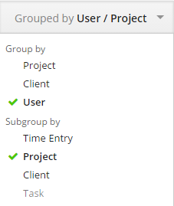
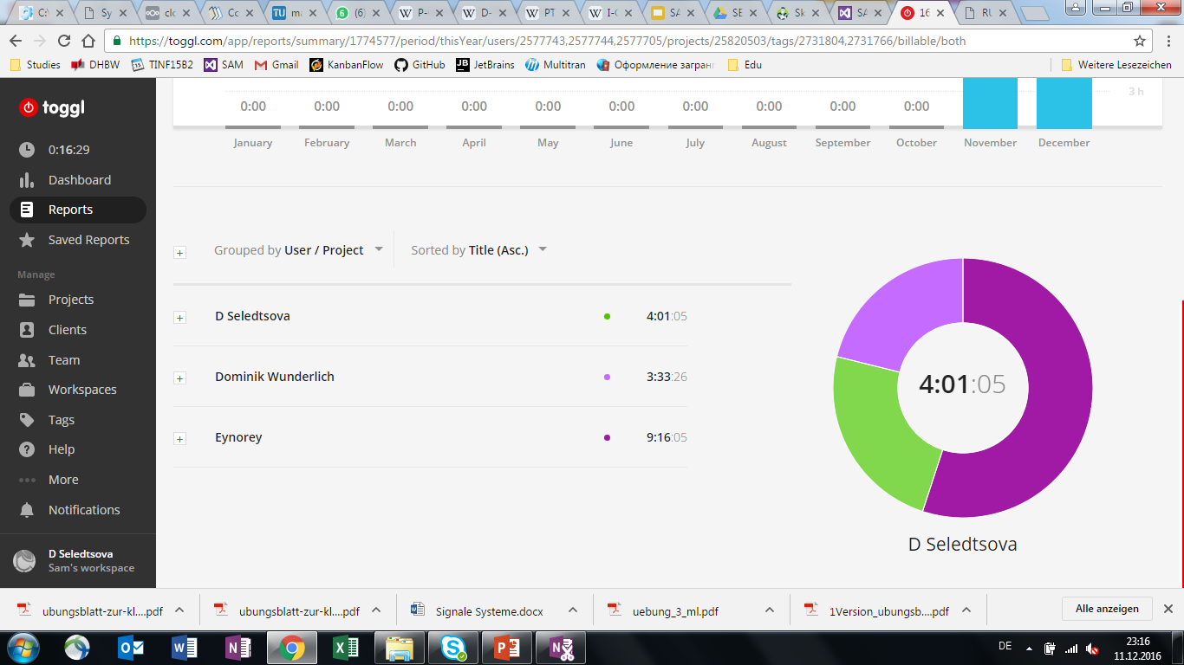


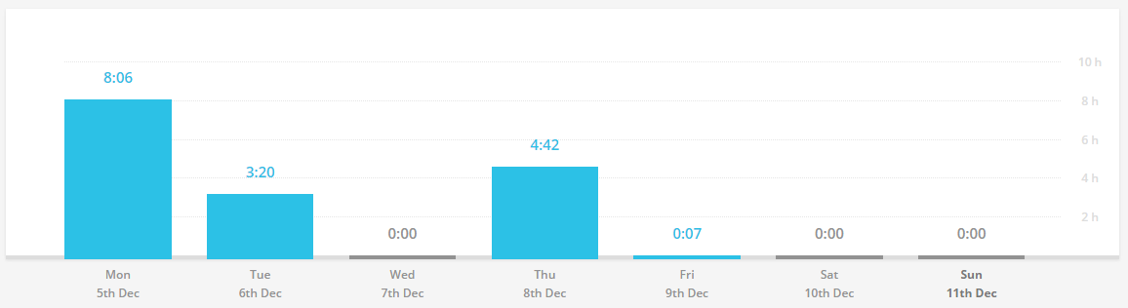
PLANING
Visuals

Slide 17

^{ARCHITECTURE}
Gamedevs- games of the future

Slide 18
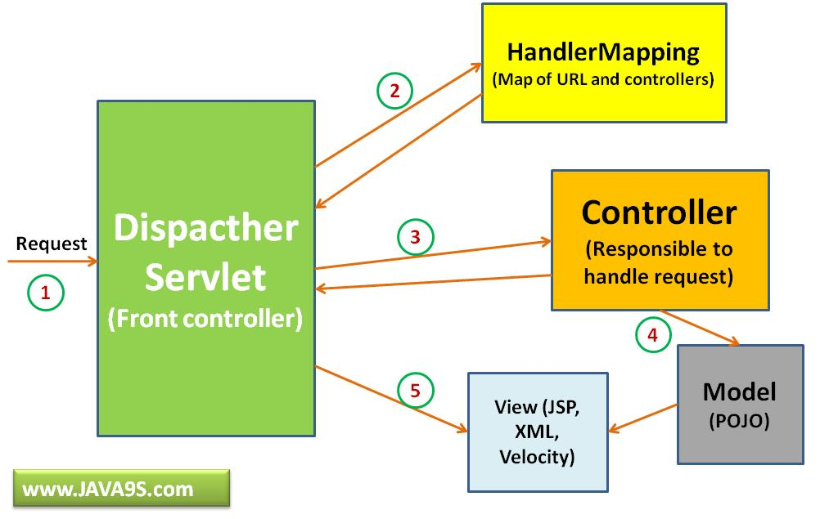
ARCHITECTURE – Unity Native Model
Scripts
Dispatcher Servlet
View (AngularJS)

Slide 19
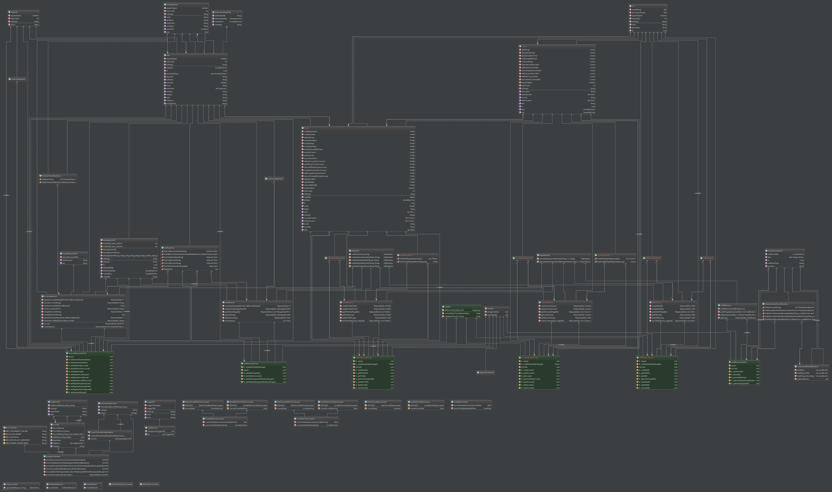
ARCHITECTURE - CLASS DIAGRAM
Overall Software Structure
Definition & Methods
user & profile
[MODEL]
Definition & Methods
course & skill
[MODEL]
Resources & Repositories
profile, skill & course repository
and resource classes
[CONTROLLER]
Testing
test classes
Miscellaneous
date+time classes & converters,
error handling

Slide 20

^{TESTING}
Gamedevs- games of the future

Slide 21



AUTOMATED TESTING FRAMEWORKS
Quality Assurance

Slide 22

THANK YOU
FOR YOUR ATTENTION
WE WILL BE HAPPY TO ANSWER YOUR QUESTIONS

